Slide 1
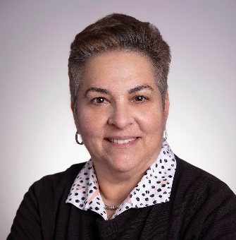
Lisa Shalett, Managing Director
Chief Investment Officer and Head of the Global Investment Office
Lisa Shalett is Chair of the Global Investment Committee and Chief Investment Officer for Morgan Stanley Wealth Management. She is also Head of the Global Investment Office and has served on the Wealth Management Operating Committee since 2013. In her current roles, she develops portfolio solutions that leverage the Firm’s strategic and tactical asset allocation advice to meet client goals delivered through both scaled and customized solutions.
Lisa leads the development of all asset allocation models, global investment due diligence and portfolio analytics. She also oversees the GIC’s models and Outsourced Chief Investment Office (OCIO) and Family Office mandates, which collectively have over $250 billion in assets under management. In addition, Lisa is responsible for Morgan Stanley Wealth Management thought leadership and publishes special reports on topics of importance for practitioners and clients.
In 2024, Lisa took on an expanded role focused on leveraging Morgan Stanley’s best intellectual capital across Wealth and Investment Management for all clients.
Prior to joining the Firm in September 2013, Lisa served as chief investment officer of Bank of America Merrill Lynch Global Wealth Management. Previously, she held several senior roles at Alliance Bernstein during her 18-year tenure, including chairman and chief executive officer of Sanford C. Bernstein, LLC, and chief investment officer and head of Alliance-Growth Equities.
Lisa holds a dual Sc.B. degree in applied mathematics and economics from Brown University and an MBA from Harvard Business School. She is a Henry Crown fellow of the Aspen Institute, a founding member of the Financial Fellowship, NYC Chair of iMentor, and an advisory board member at both the Statue of Liberty/Ellis Island Foundation and the Madison Boys & Girls Club of New York.

